Slide 1
Overview of Current and Forthcoming GALEX Search Capabilities and Data Products
Current Search Options
New GALEX Fluxes
gPhoton

Slide 2
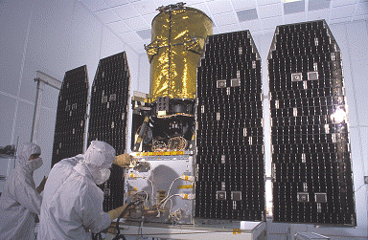
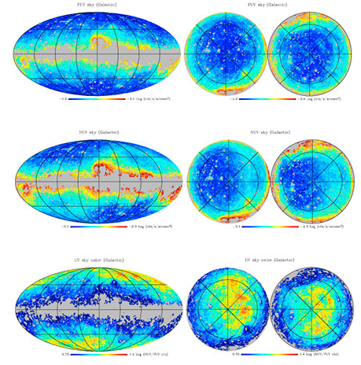
The GALEX Mission
Originally planned to last 2.5 years, mission lasted 10 years and the spacecraft was “retired” just this past year.
FUV and NUV camera, though FUV failed in June 2009.
Wide variety of imaging surveys: All-Sky, Medium, Deep, Nearby Galaxy…+ guest investigations.
Spectroscopic survey (Medium Spect. Survey)…+ guest investigations.
Legacy surveys targeting special areas / targets after completion of Prime Mission.
Data provided as image tiles (circular FoV) at a “visit” level, as well as “coadd” consisting of multiple visits at the same pointing.
Associated catalog of FUV and NUV sources, but with duplicates.

Slide 3
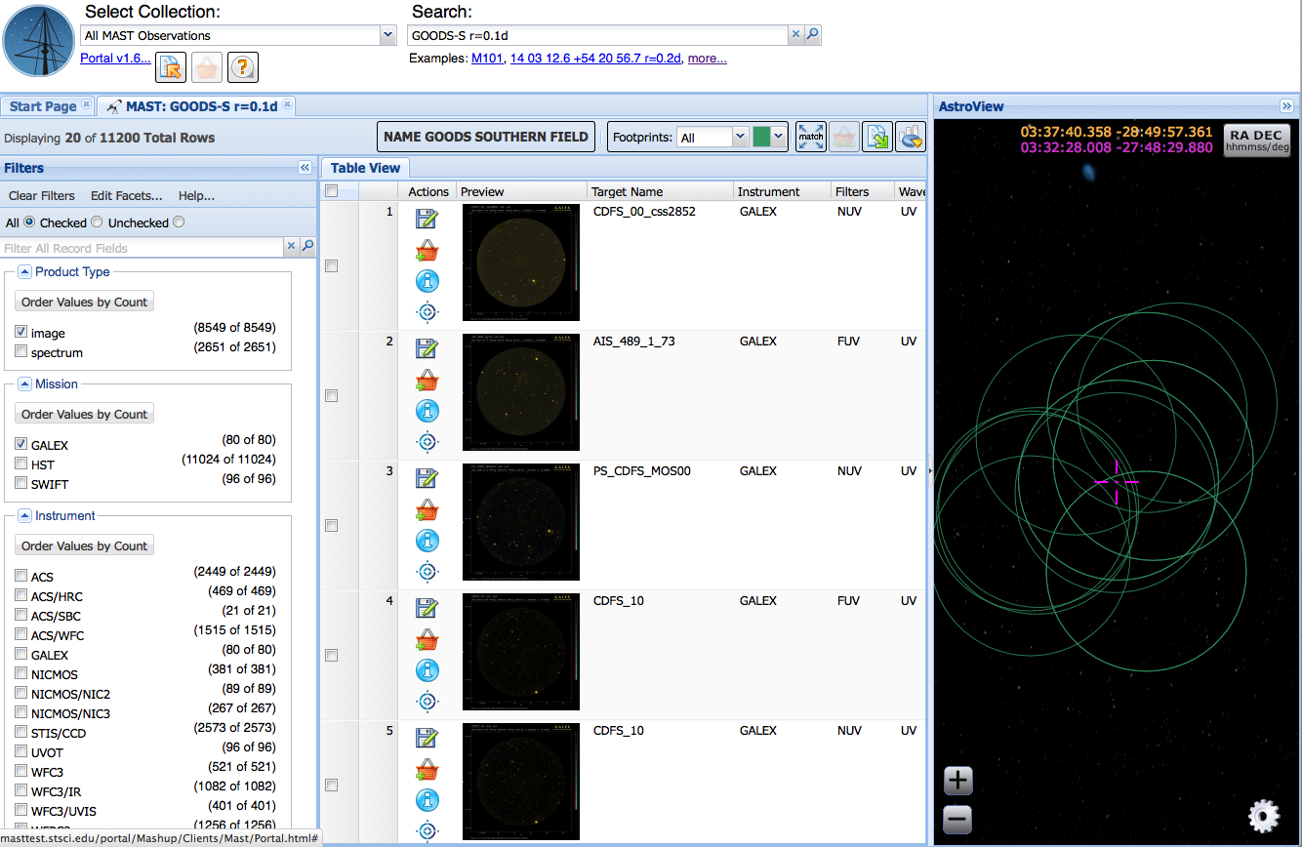
Discovery Portal
Many GALEX GI and Legacy Programs were conducted in parallel, or subsequent to, large HST programs.

Slide 4
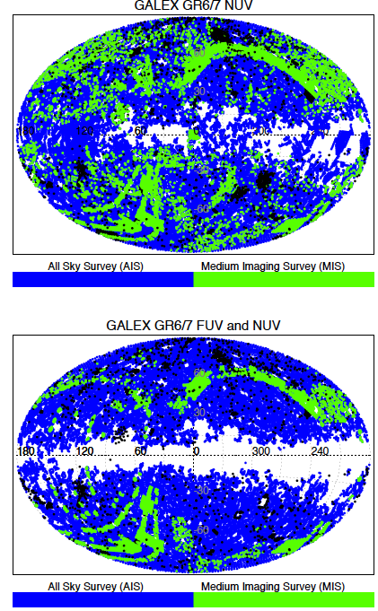
Incoming Data – GCAT + Bianchi Catalogs
GCAT (Seibert et al.)
AIS and MIS version through GR6
Kepler-field-only version including GR7
NUV-defined, FUV measured using NUV positions and apertures
Bianchi et al. Catalog
Includes all AIS and MIS tiles through GR7 (end of 2012)
Sources cross-matched with SDSS DR9, GSC-II, PanSTARRS, 2MASS

Slide 5
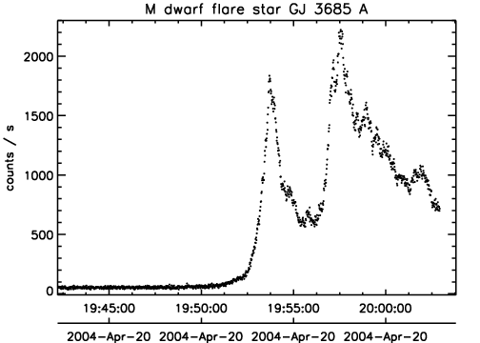
Incoming Data - gPhoton
gPhoton
Time-tagged database of every photon observed with GALEX (~1.5 trillion photons).
Python-based package + web interface.
Users can create lightcurves, movies, stacked intensity maps, using any set of photons.
User-defined coordinates, apertures, time resolution.
New science areas: transients, high-time-resolution variability, concurrence with other missions.
Can do science in two modes: Look at gPhoton data from lists of known objects, or animate a patch of sky and see what’s there!
Beta testing is available now! Contact Chase Million at chase.million@gmail.com

Slide 6
Progress on Past MUG Comments
“The highest priority MUG request: Availability of GALEX data and quality assurance needs to be ascertained for the post-NASA period. This action may require interceding by the Program Scientist and Program Executive at NASA HQ .”
All “normal” data up to and including the CalTech era have been released to the public as GR7.
All of the new “scan-mode” data have been delivered to MAST, but the GALEX team was never able to adjust their pipeline to fully process those data at a level they are comfortable with. There are no plans for them to work on this further in the future.
For the scan-mode data, therefore, we effectively have a “raw” version of the data. We want to release these to the public, but need to think about where and how best to serve it out.
There is also some proprietary data from the CalTech observing season that can not be released until that proprietary data lapses. We have the data, but do not yet have exact dates on when each program’s data can be made public.

Slide 7
The Future
Integration with the Portal, especially, how do we maintain the legacy of GalexView? GALEX users have been using same access points for years, need to ensure transition is as enticing and smooth as possible.
gPhoton: How to make it a tool that people will want to use? Arguably the GALEX spacecraft’s lasting legacy researchers can use for years to come.
Besides HST, there are no new UV missions on the horizon (GALEX is the last and greatest). How can we make sure the archive can support the UV community while also helping them plan for the next big thing?
What are some of the important topics to discuss from your perspective? UV legacy? Complements to current and future missions? Data access / discoverability? Tools that are missing?

Slide 8
Supplemental Slides – Please Review

Slide 9
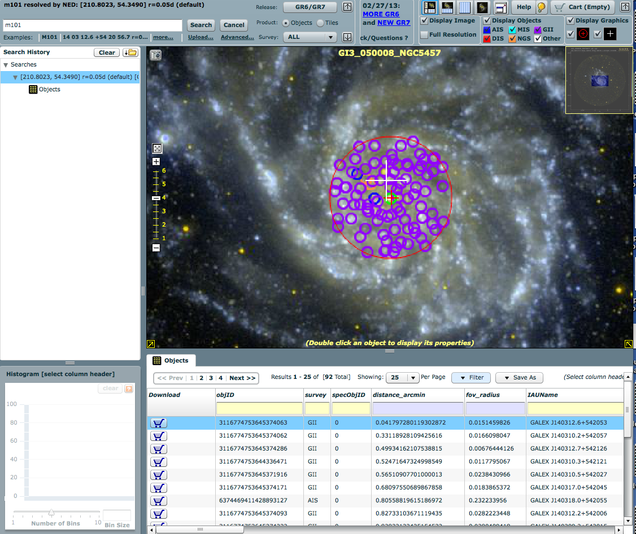
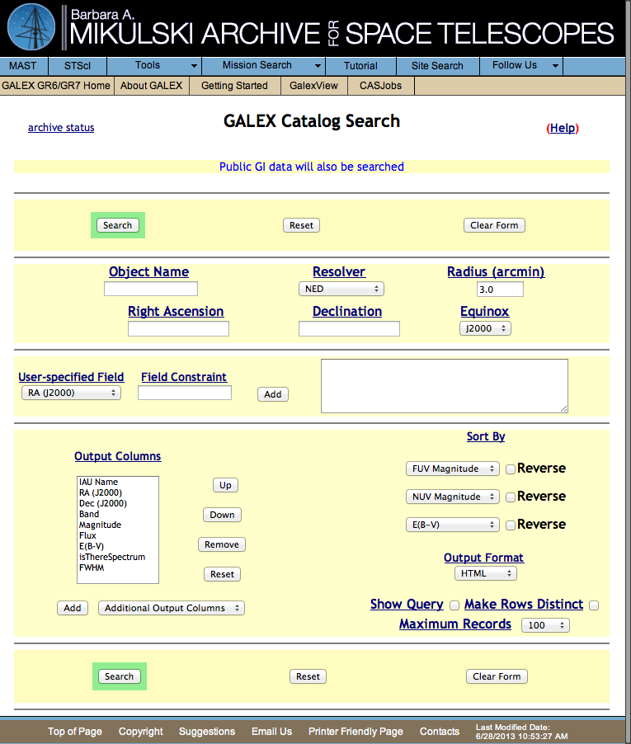
“Classic” MAST Search Form / GalexView
MAST Search Form – Not used heavily: http://galex.stsci.edu/GR6/?page=mastform
GalexView: An ancestor of the Discovery Portal? Used by a significant fraction of the GALEX community. Includes download basket, data overlays, filtering. Similar to HLA in behavior and design, but specific to GALEX. http://galex.stsci.edu/GalexView/

Slide 10
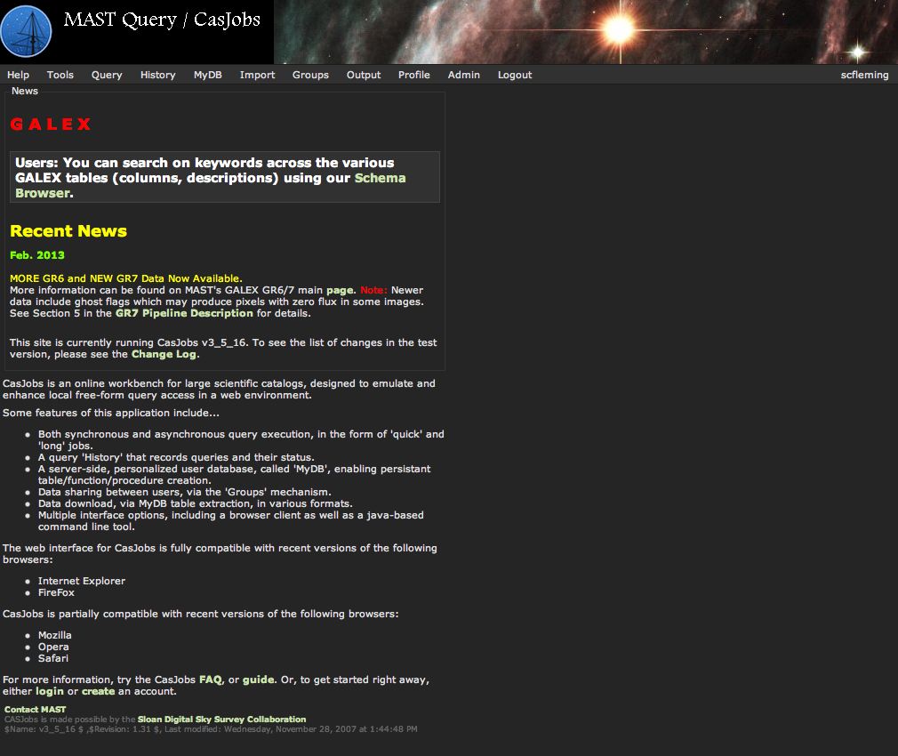
GALEX CasJobs: SQL Access To Tables
http://galex.stsci.edu/casjobs/
Like Kepler CasJobs, allows for powerful queries on both the tile-level and source-level tables.
This resource is currently used more effectively by the GALEX community than the Kepler community.
GALEX CasJobs includes a Schema Browser, allowing users to search for keywords in table columns and descriptions.
Both Kepler and GALEX tables can be accessed with MAST CasJobs. The two different URLs simply point to different Intro Pages at the front end.

