Slide 1
MAST High-Level Science Products (HLSP)
http://archive.stsci.edu/hlsp
Community-contributed, fully processed
Include a wide variety of different types:
Image atlases
Spectral atlases
Surveys
Individual objects
Catalogs
Composite spectra
Time series datasets
Theoretical models

Slide 2
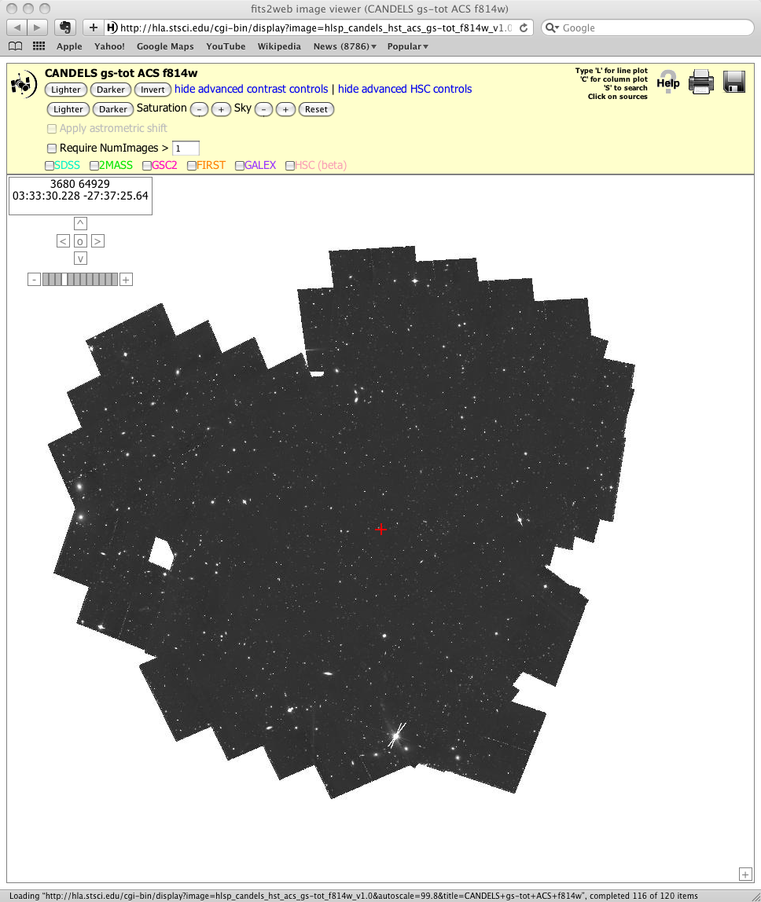
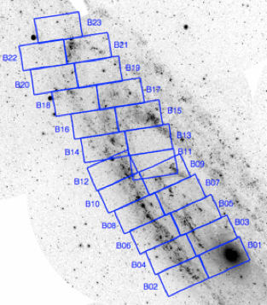
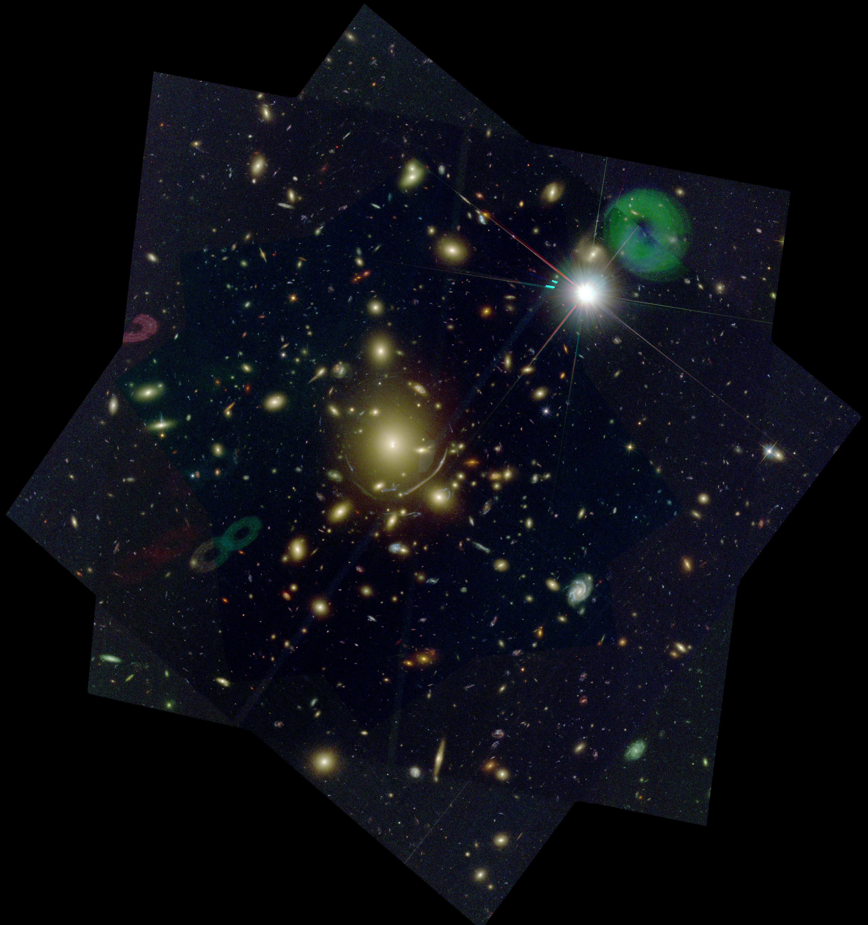
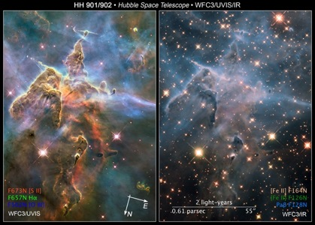
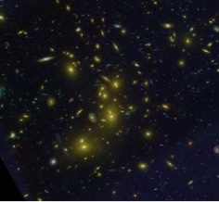
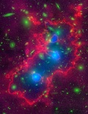
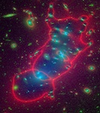
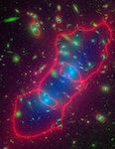
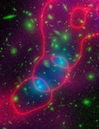
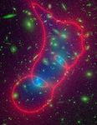
Imaging HLSPs
MCT programs: CANDELS (PI: Faber, Ferguson)
PHAT (PI: Dalcanton)
CLASH (PI: Postman)
Frontier Fields
(PI: Lotz/Mountain)
Cluster lensing models contributed by community
(Bradac, Ebeling, Mertin, Zitrin, Sharon, Williams)
Carina Nebula (PI: Mutchler)
HST mosaics

Slide 3
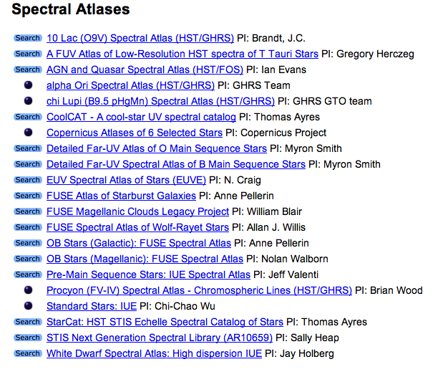
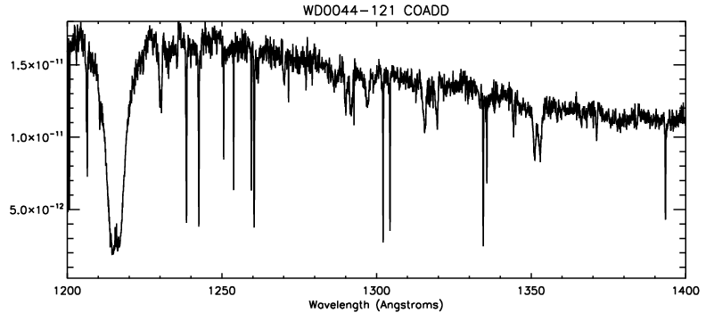
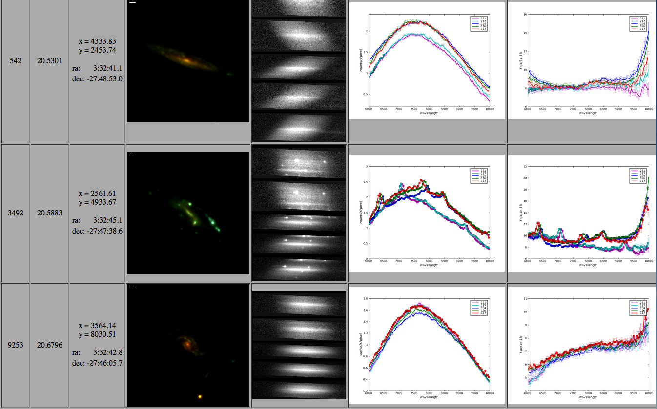
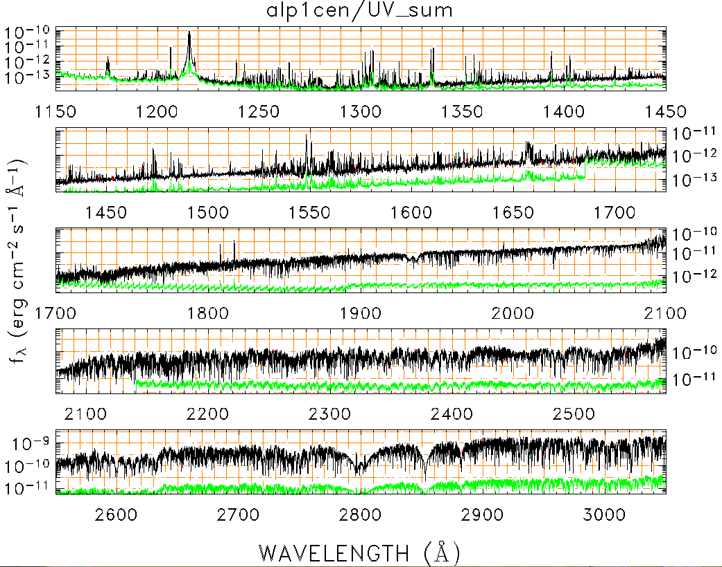
Spectroscopic HLSP
Co-added IUE White Dwarf Spectra (Holberg)
CoolCAT / StarCAT UV Atlases, several hundred stars (Ayers)
GRAPES grism spectroscopic survey, 1400 spectra from UDF (Malhotra)

Slide 4
HLSP Open Questions
Do the community think of MAST as their go-to source for HLSP, or do they just google search and visit individual people’s / team’s pages? How can we change this mentality?
Are the community motivated to share their final data with us, especially when not required by funding conditions? We have had some steady interest, but how can we motivate more groups? What roadblocks are there to encourage more group’s to share their published results at MAST?
What is the utility of such data? Is this something the community actually wants or needs? If they don’t know about data / papers on their objects of interest, they can’t possibly make use of it. Is enhancing the discoverability of such HLSPs an important goal (the most important goal)?
What key ideas do we need to be pursuing in order to make HLSP data more accessible to the community?

