Slide 1
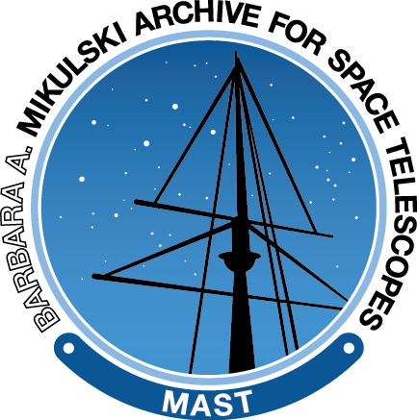
Overview of Current and Forthcoming Kepler Search Capabilities and Data Products
Current Search Options
New GALEX Fluxes
Variability Statistics

Slide 2
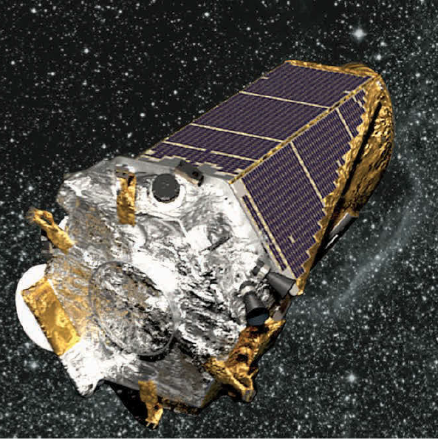
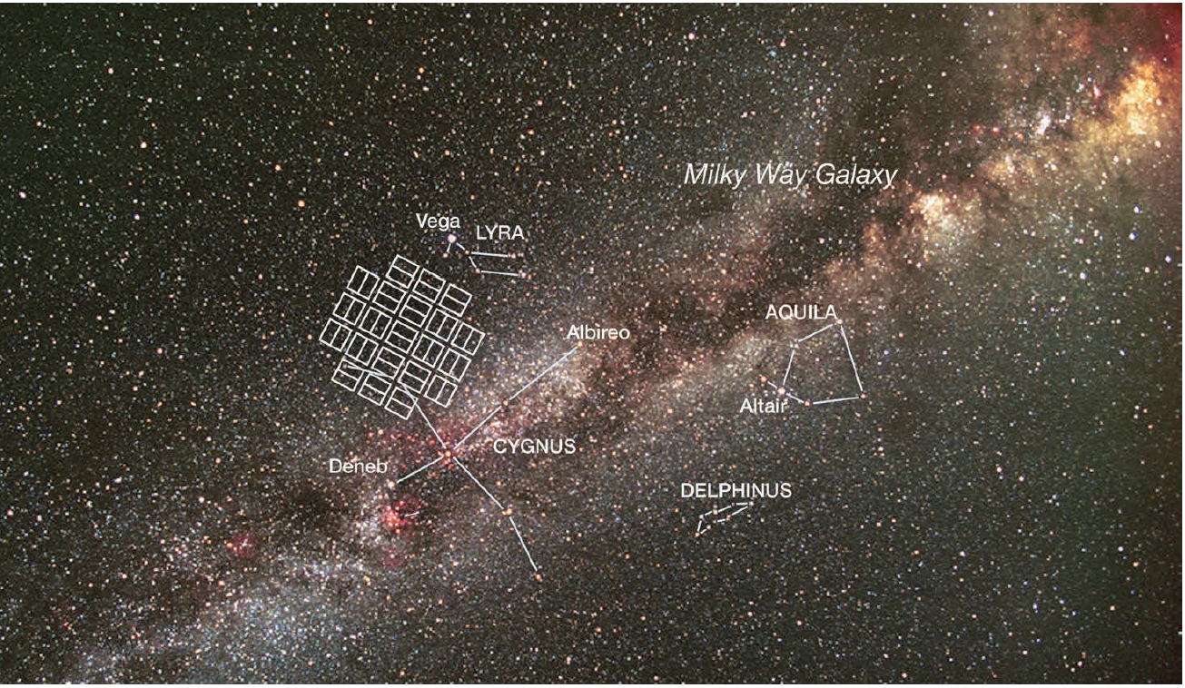
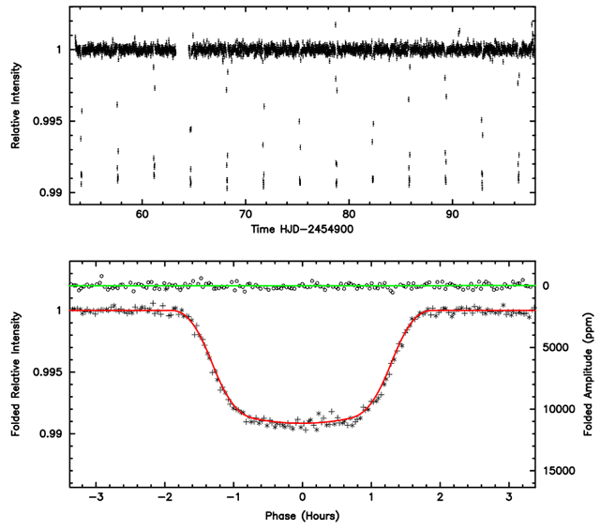
The Kepler Mission
4-years of operations (now standing by with 2 reaction wheels).
Nearly-continuous coverage in ~3 month intervals (“Quarters”).
Broad-band optical filter (400-900 nm).
Relative photometric precision of a few 10’s ppm.

Slide 3
The Kepler Mission
Brief overview of older data retrieval methods at end of presentation.
Start with some specific examples of Kepler use in the Portal.
Quick update on new UV fluxes coming soon.
New data MAST will provide soon: variability statistics.
Maximize time for open discussion.

Slide 4
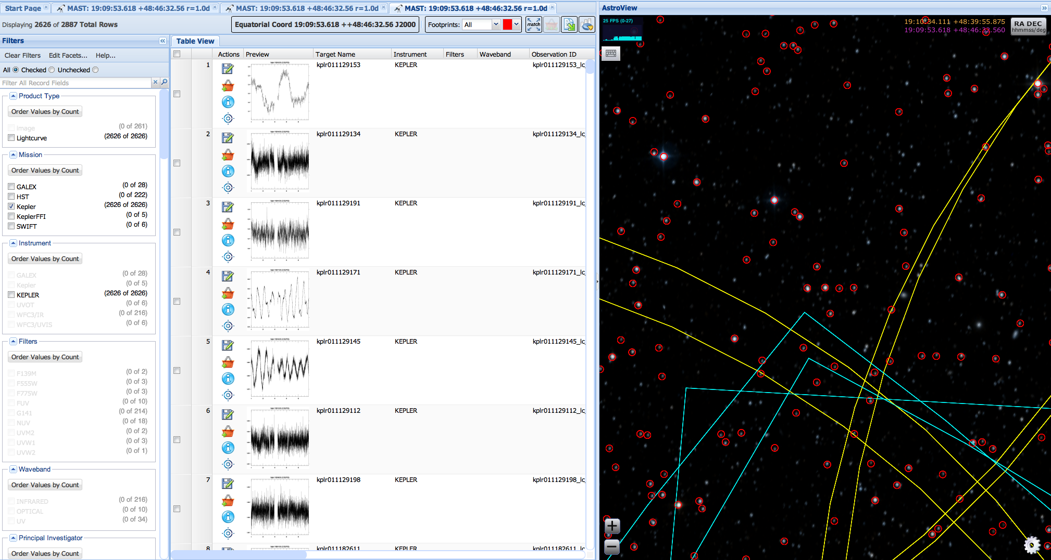
Discovery Portal – A Kepler Perspective
Kepler
GALEX
Swift
Previews are for the latest Quarter for each star.

Slide 5
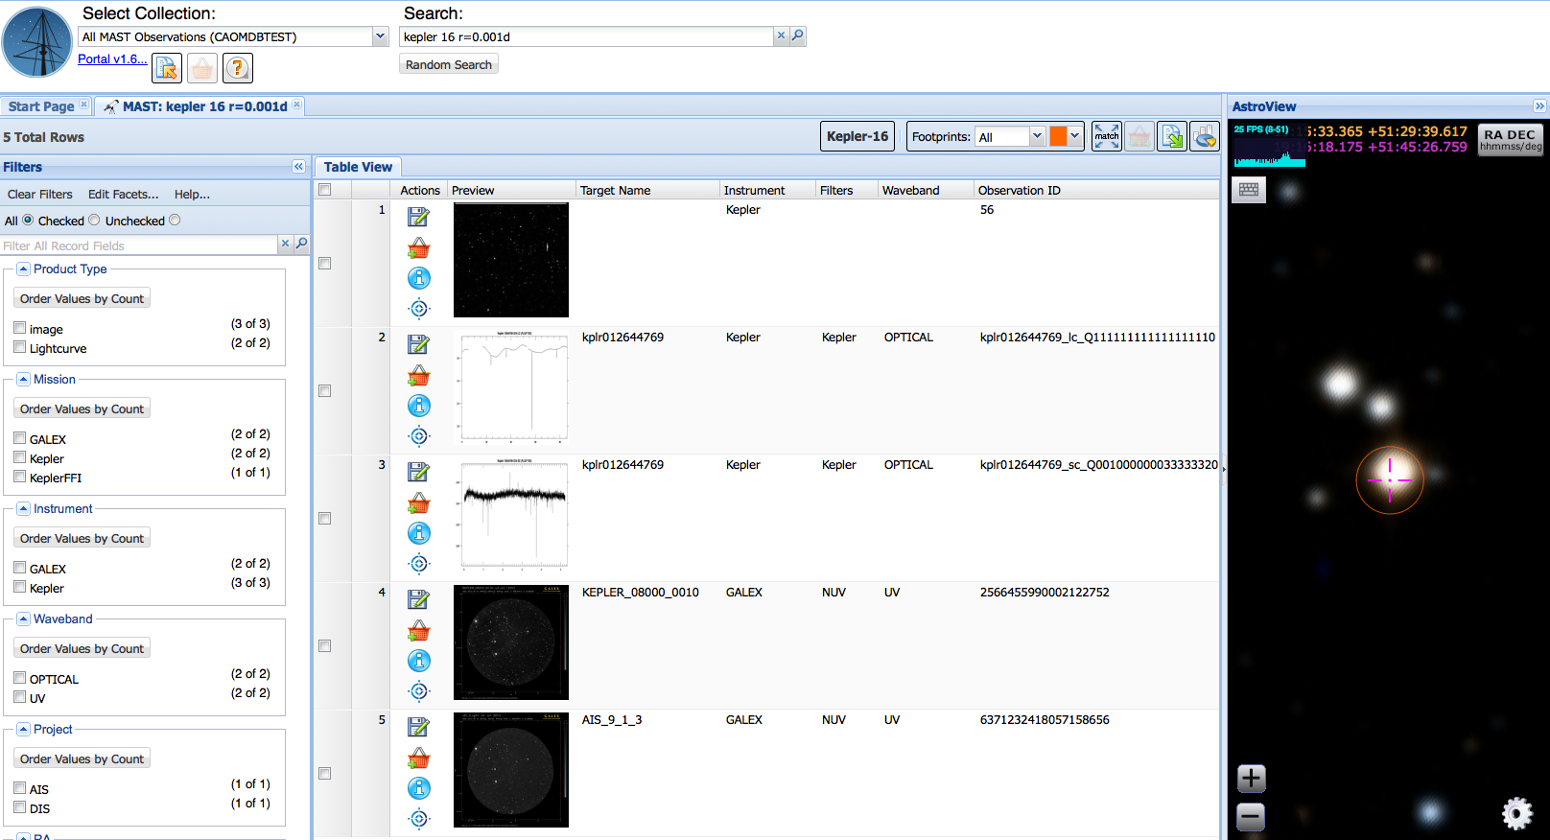
Discovery Portal – A Kepler Perspective
Short and Long Cadence as separate rows. Avoids crowding search results.
Number of datasets (lightcurves) per Quarter encapsulated in ObsID.

Slide 6
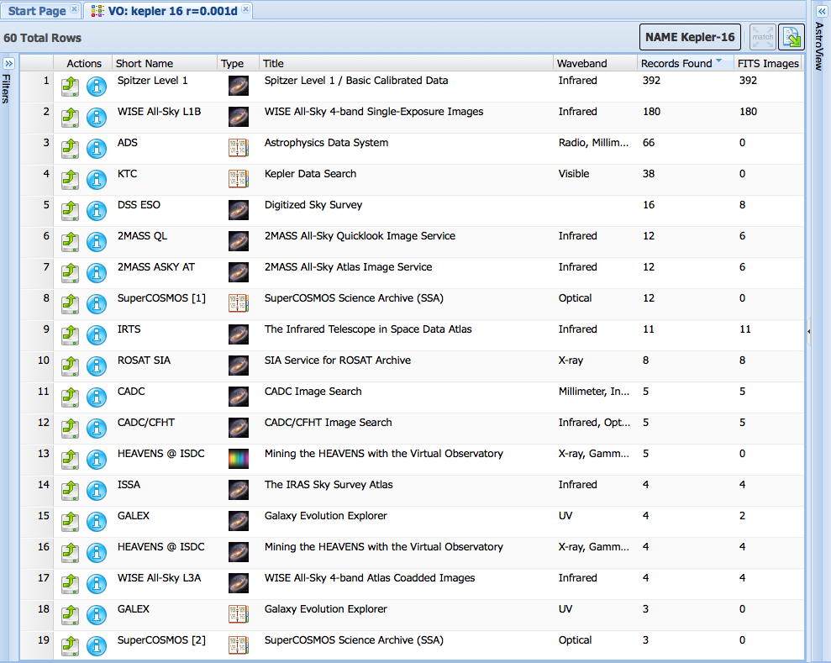
Discovery Portal – A Kepler Perspective
Cross-Search with VO allows users to discover complementary data at other wavelengths: radio, IR, high energy, that they may not be aware of.

Slide 7
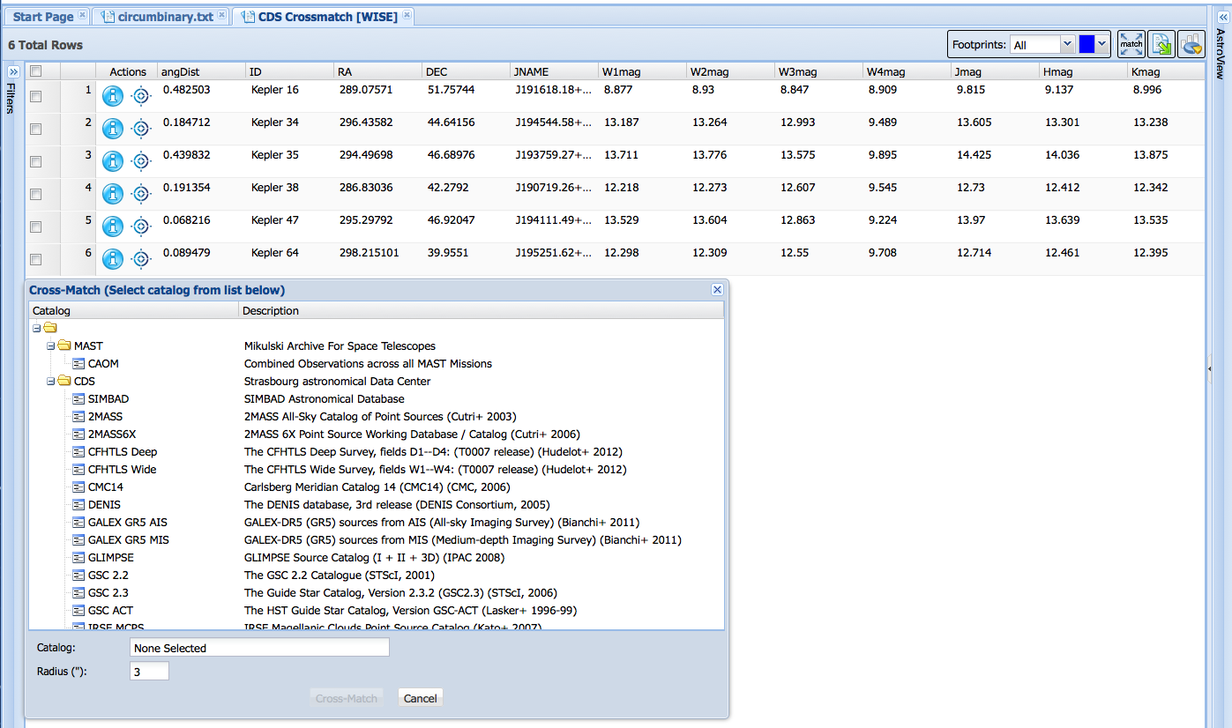
Discovery Portal – A Kepler Perspective
Cross-Match tool with MAST and CDS data allows for quick table creation. Here I cross-matched Kepler circumbinary planets with WISE to get J,H,K and 4-filter WISE fluxes in seconds.

Slide 8
Incoming Data (Near-Term)
There will be more papers written about Kepler’s stars than its planets.

Slide 9
Incoming Data – GALEX Fluxes From GCAT
GR6
GR7
New GALEX GCAT will be made available as a table in CasJobs, and in the Target table, replacing the current FUV and NUV fluxes previously cross-matched by MAST using GR6.

Slide 10
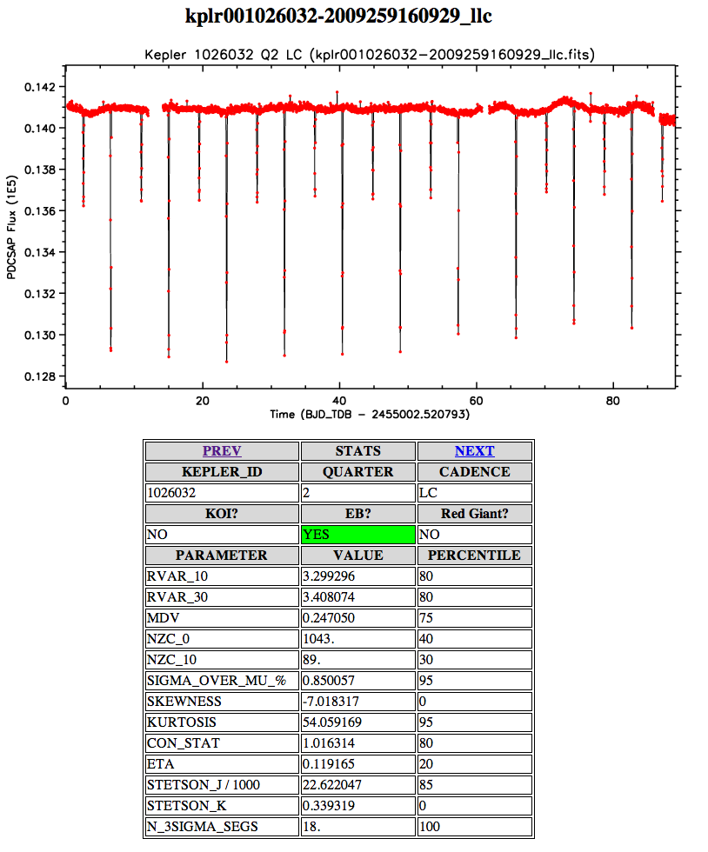
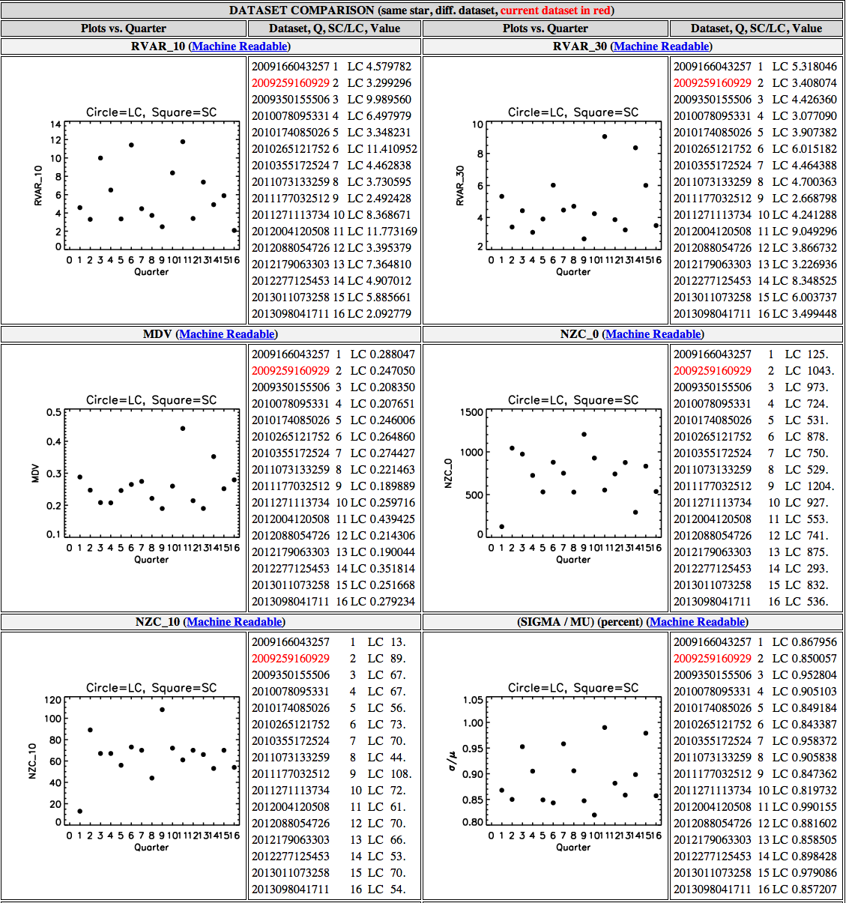
Incoming Data – Variability Stats
Added as a table to CasJobs, in Preview pages. Treat as a MAST HLSP.
Can empirically select subpopulations via clustering.
Can study changes through time.

Slide 11
Progress on Past MUG Comments
“Matching of the photometric light curves between monthly and/or quarter periods for all sources would provide a high return to both the community and science, if done sooner than later. It would be beneficial if the Kepler team, who has the expertise to enable this to be accomplished, could work in a timely fashion with the MAST Team to enable this now.”
This is an active area of research by experts in the field; one group is exploring use of Bayesian analysis on statistical entropy criteria, testing their results by injecting simulated variability and analyzing recovery of the signals.
A “moderate” effort by MAST would due more harm than good. Many users would be dissuaded to think about the problem and rely on the MAST stitching.
Many science users don’t even like using the Kepler team’s PDC lightcurves; power users re-extract their own lightcurves from the raw Kepler photometry in the Target Pixel Files.
This is also the suggestion by members of the Kepler SOC, and a suite of python routines have been created to assist users in detrending, extracting, and even stitching.
Our response was that the problem was much too challenging to be done correctly (and robustly) at this time. One avenue for medium-term investigation is to consider making the python tools from M. Still et al. available through MAST in some capacity, and remains a possibility to explore.

Slide 12
The Future
What to add as Kepler transitions to a legacy mission? Which communities are underserved currently? How will people want to use Kepler data 5, 10, 20 years from now? Which data will they want (and will we have the tools for them to use it)?
Lessons learned applied to K2 and TESS? Knowledge gained can and should be applied to K2 (if it happens) and TESS going forward. Development of tools and services for Kepler likely to be relevant to future missions.
Improving data linkage and connectivity with Exoplanet Archive? “Two-body” problem where NExScI has all the transit data, MAST has the actual data and star information. Any improvement in linking the two is beneficial!
Enhance existing webtools and/or add new ones? Catalog and preview plotter (R. Thompson), integration of Pyke (M. Still)? NExScI precedence for offering analysis tools along with data (not just a data repository).
What are some of the important topics to discuss from your perspective? Kepler legacy? Data usage? How do you want to use or browse Kepler data for your research? What do you think other astronomers will want from the Kepler mission moving forward?

Slide 13
Supplemental Slides – Please Review

Slide 14
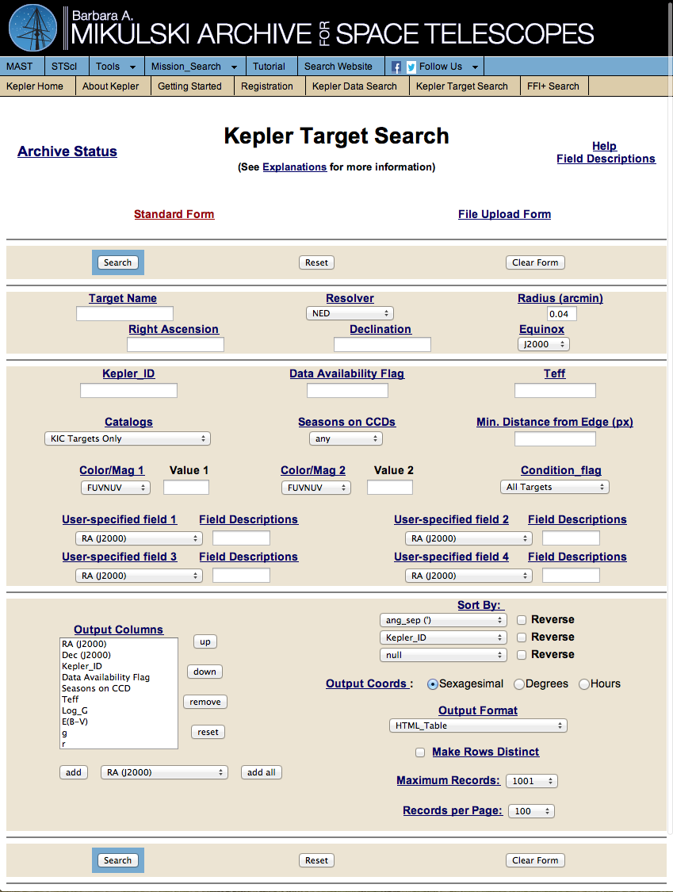
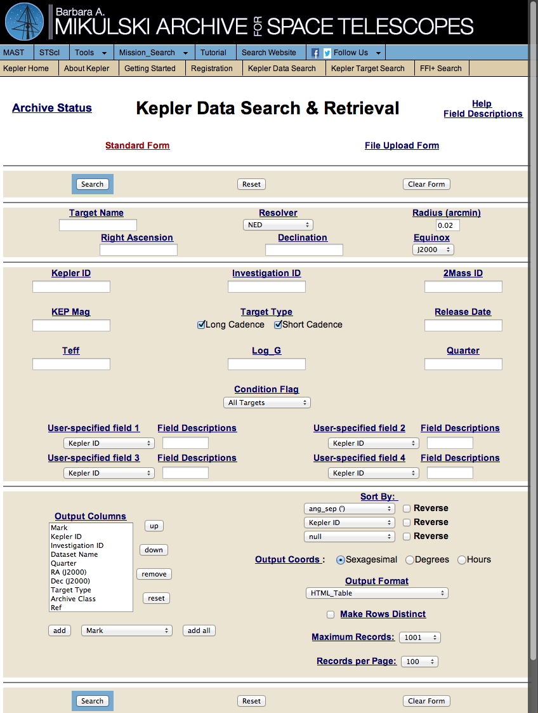
“Classic” MAST Search Forms
http://archive.stsci.edu/kepler/data_search/search.php
http://archive.stsci.edu/kepler/kepler_fov/search.php
Target Search: Info on stars in Kepler field-of-view, even if they were not observed. Fluxes in various filters, stellar properties, proper motions.
Data Search: Info on Kepler observed lightcurves: cadence type, start/end times, CDPP values, crowding/contamination.

Slide 15
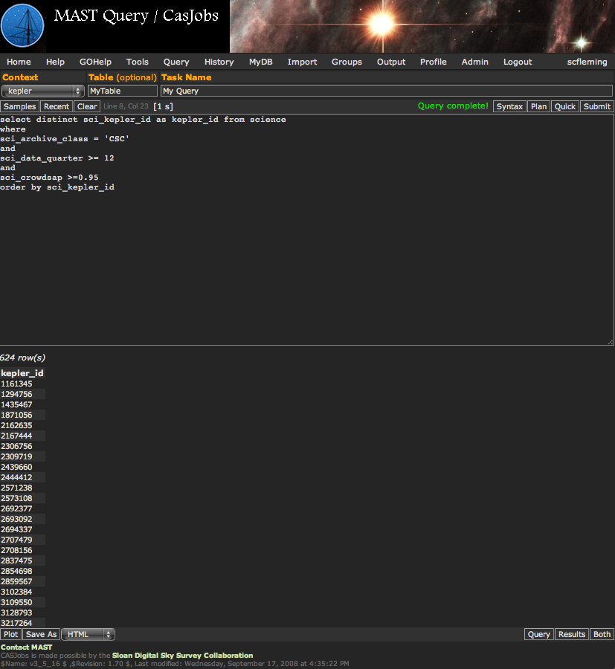
Kepler CasJobs: SQL Access To Tables
http://mastweb.stsci.edu/kplrcasjobs/
Users can conduct powerful SQL queries to search for data or targets without having to download large amounts of Kepler FITS files.
In the example on the left, I selected all Kepler IDs observed in Short Cadence mode on or after Quarter 12 with a crowding values > 0.95. This effectively downselects from hundreds of thousands of targets to 624 in a matter of seconds.
All user queries are stored in CasJobs for later use/retrieval. This includes the SQL command used to generate your output table, so you can re-use scripts in the future.
There is a built-in SQL implementation of cross-matching that allows you to cross-match targets based on RA, DEC between tables, including your own tables that you can upload into CasJobs.

Slide 16
WGET and Pre-Packaged Tarballs
http://archive.stsci.edu/kepler/publiclightcurves.html
Users can generate custom wget scripts following simple instructions under “Search & Retrieval” -> “Download Lightcurves”.
Create set of wget commands in a text file, make it executable and run from Linux/Mac terminal.
No restrictions on number of files or size limits.
Users can also download pre-packaged tar archives for all lightcurve files from a given Quarter, or sets comprised of KOI’s, red giants, or eclipsing binaries.

