Slide 1
AstroTag
MUG meeting, STScI
December 2014

Slide 2
Data Tagging
Storing associations between data sets and tags (words/phrases)
IPPPSSOOT <=> {w_1, w_2, …, w_n}
Tags have meaning
Identify types of objects within a data set
E.g. Dwarf irregular galaxies
Identify data related to a particular area of study
E.g. Galaxy interactions, galaxy formation

Slide 3
Tagging from a Thesaurus
Tagging with concepts
Multiple labels in multiple languages can be used to express the same concept
Concept labels can change without changing concept/data set relations (& v.v.)
Relationships between concepts add additional meaning
Broader term (BT), narrower term (NT), related term (RT), others

Slide 4
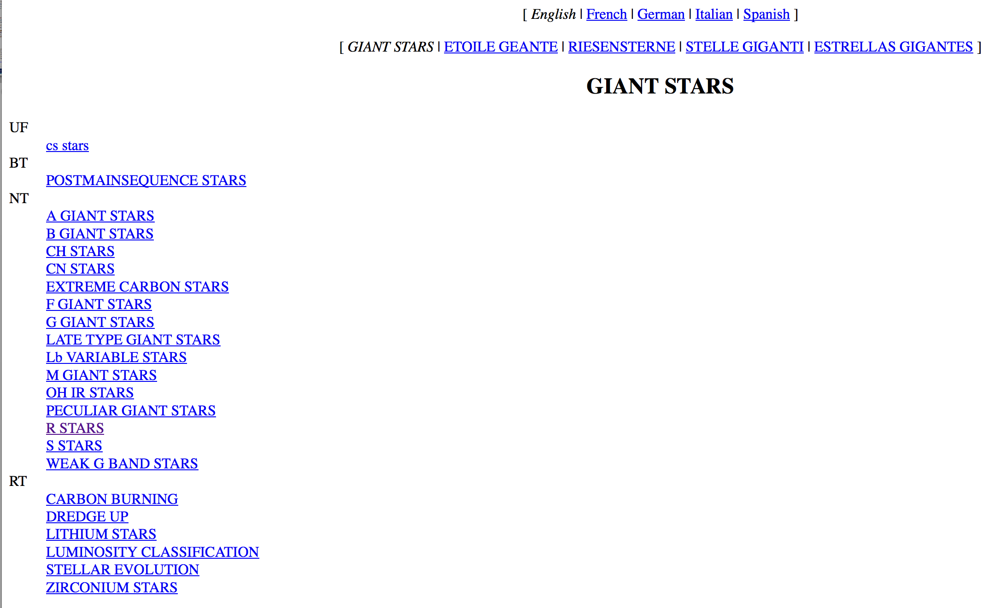
http://www.mso.anu.edu.au/library/thesaurus/english/GIANTSTARS.html

Slide 5
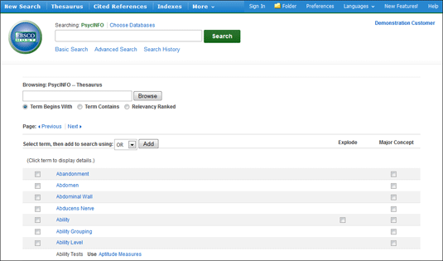
http://support.ebsco.com/knowledge_base/detail.php?id=7047

Slide 6
Generating Associations
Concept labels <-> Papers <-> Datasets
Automatic matching of labels with papers/proposals
Manual association of papers with data sets
Catalogs
Type, morphology, etc.
User input (APT, etc.)

Slide 7
Thesaurus-enabled Features
Hierarchical browsing
Search (with browsing)
Result Filtering
Breadcrumbs
Tag clouds
* Customized data delivery
* Topic ranking for data sets through citation mining.

Slide 8
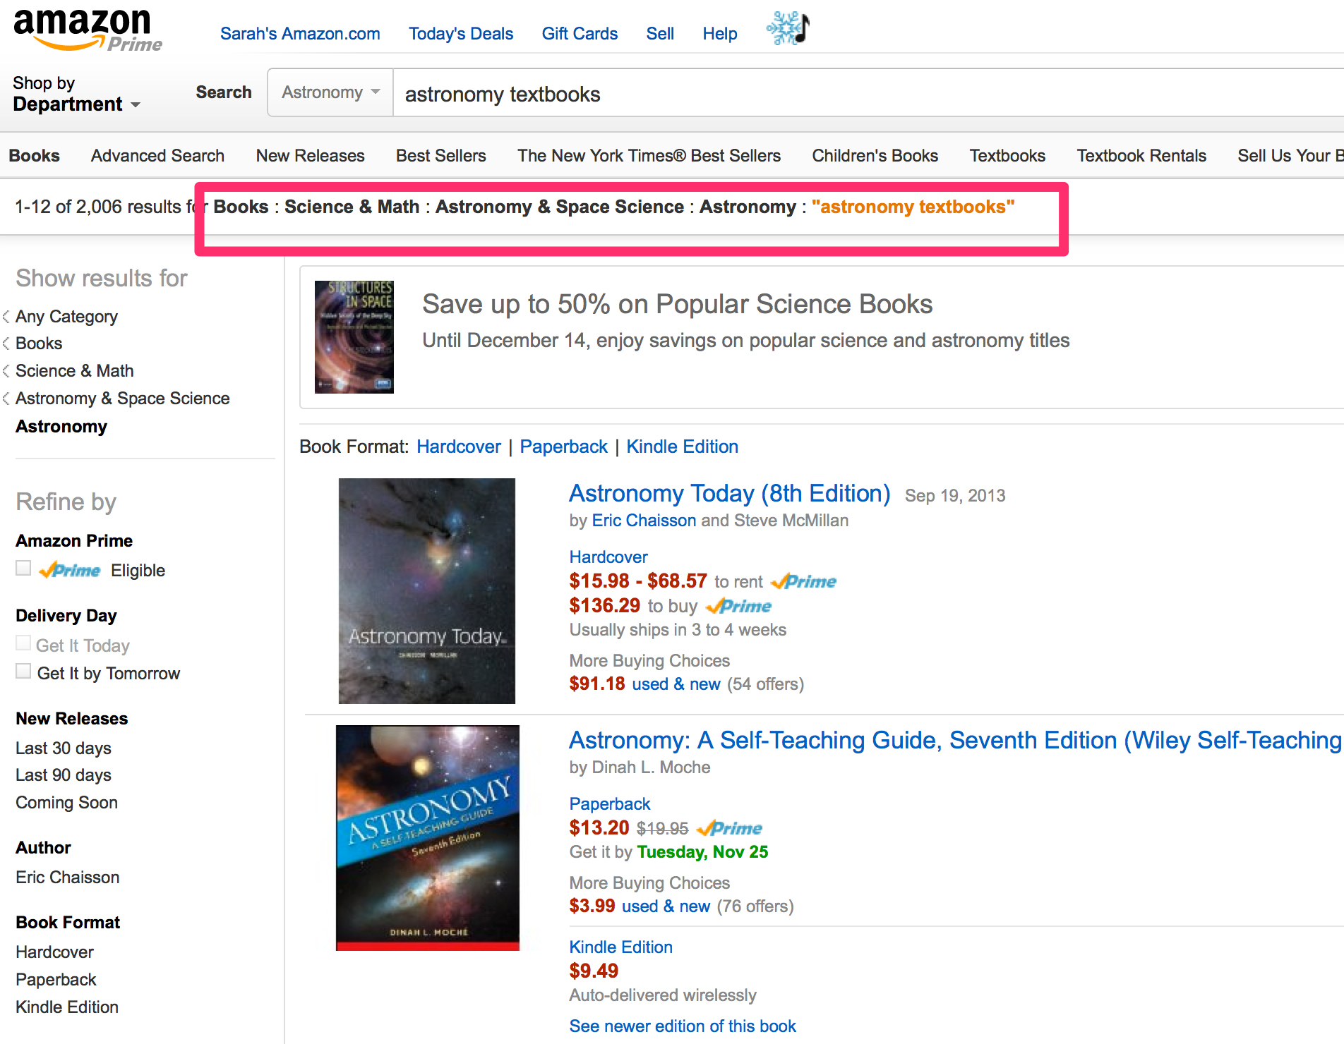
www.amazon.com

Slide 9
Choosing a Tag Set
Shape of tree:
Top-level terms
Depth
Poly-hierarchy
Are the right concepts with the right labels available?
Astroparticle physics vs. Particle astrophysics
What level of the concept tree do we tag at?

Slide 10
The UAT
Unified Astronomy Thesaurus (astrothesaurus.org)
Community authored/edited thesaurus, was maintained by CfA, but is now maintained by AAS
Combines IVOAT, PACS, journal keywords
Creative Commons Licensed

Slide 11
UAT Continued
Pros
15 top-level terms (easy to browse)
Community buy-in
Web standards (SKOS/RDF)
Caveats
Not necessarily designed with tagging and search in mind
Sometimes consensus means slow to change
Combining RDF and relational data can be tricky

Slide 12
Thesaurus Evaluation
 | UAT | IVOAT
# concepts/labels | 1909 / 3017 | 2890 / 3531
Max label length | 8 “unidentified sources of radiation outside the solar system” | 6 “low mass x-ray binary star”
Found papers/progs | 99.1% / 87.3% | ~100% / 99.2%
Not found papers/progs | 458 / 1200 | 4 / 74
Not found concepts/labels | 433 (22.7%) / 969 (32.1%) | 548 (20%) / 745 (21.1%)

Slide 13
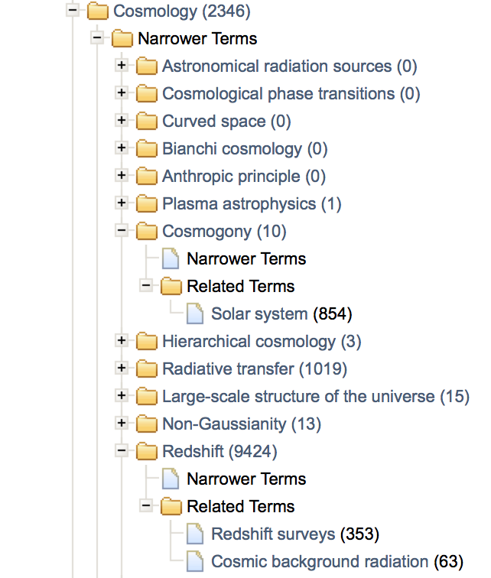

Slide 14
Next Steps
Expanding vocabulary for search
Focusing on missing labels, not structure
How best to share data, collaborate/merge with UAT
Tagging and search model

Slide 15
Open Questions
Accuracy
Human / machine error will create bad associations. How harmful is a misidentification of a type X object?
Completeness
Not everything will be tagged. How useful is a partial list of type X objects?
Provenance
How best to provide the source of tags for a data set?
E.g. The list of papers containing the tags / and data set associations.

Slide 16
Thanks!
sweissman@stsci.edu

